Slide 1

Mazen
Saad
Computer teacher

Slide 2
ICT
Grade 4

Slide 3

Enter the notebook and write the following:

Slide 4
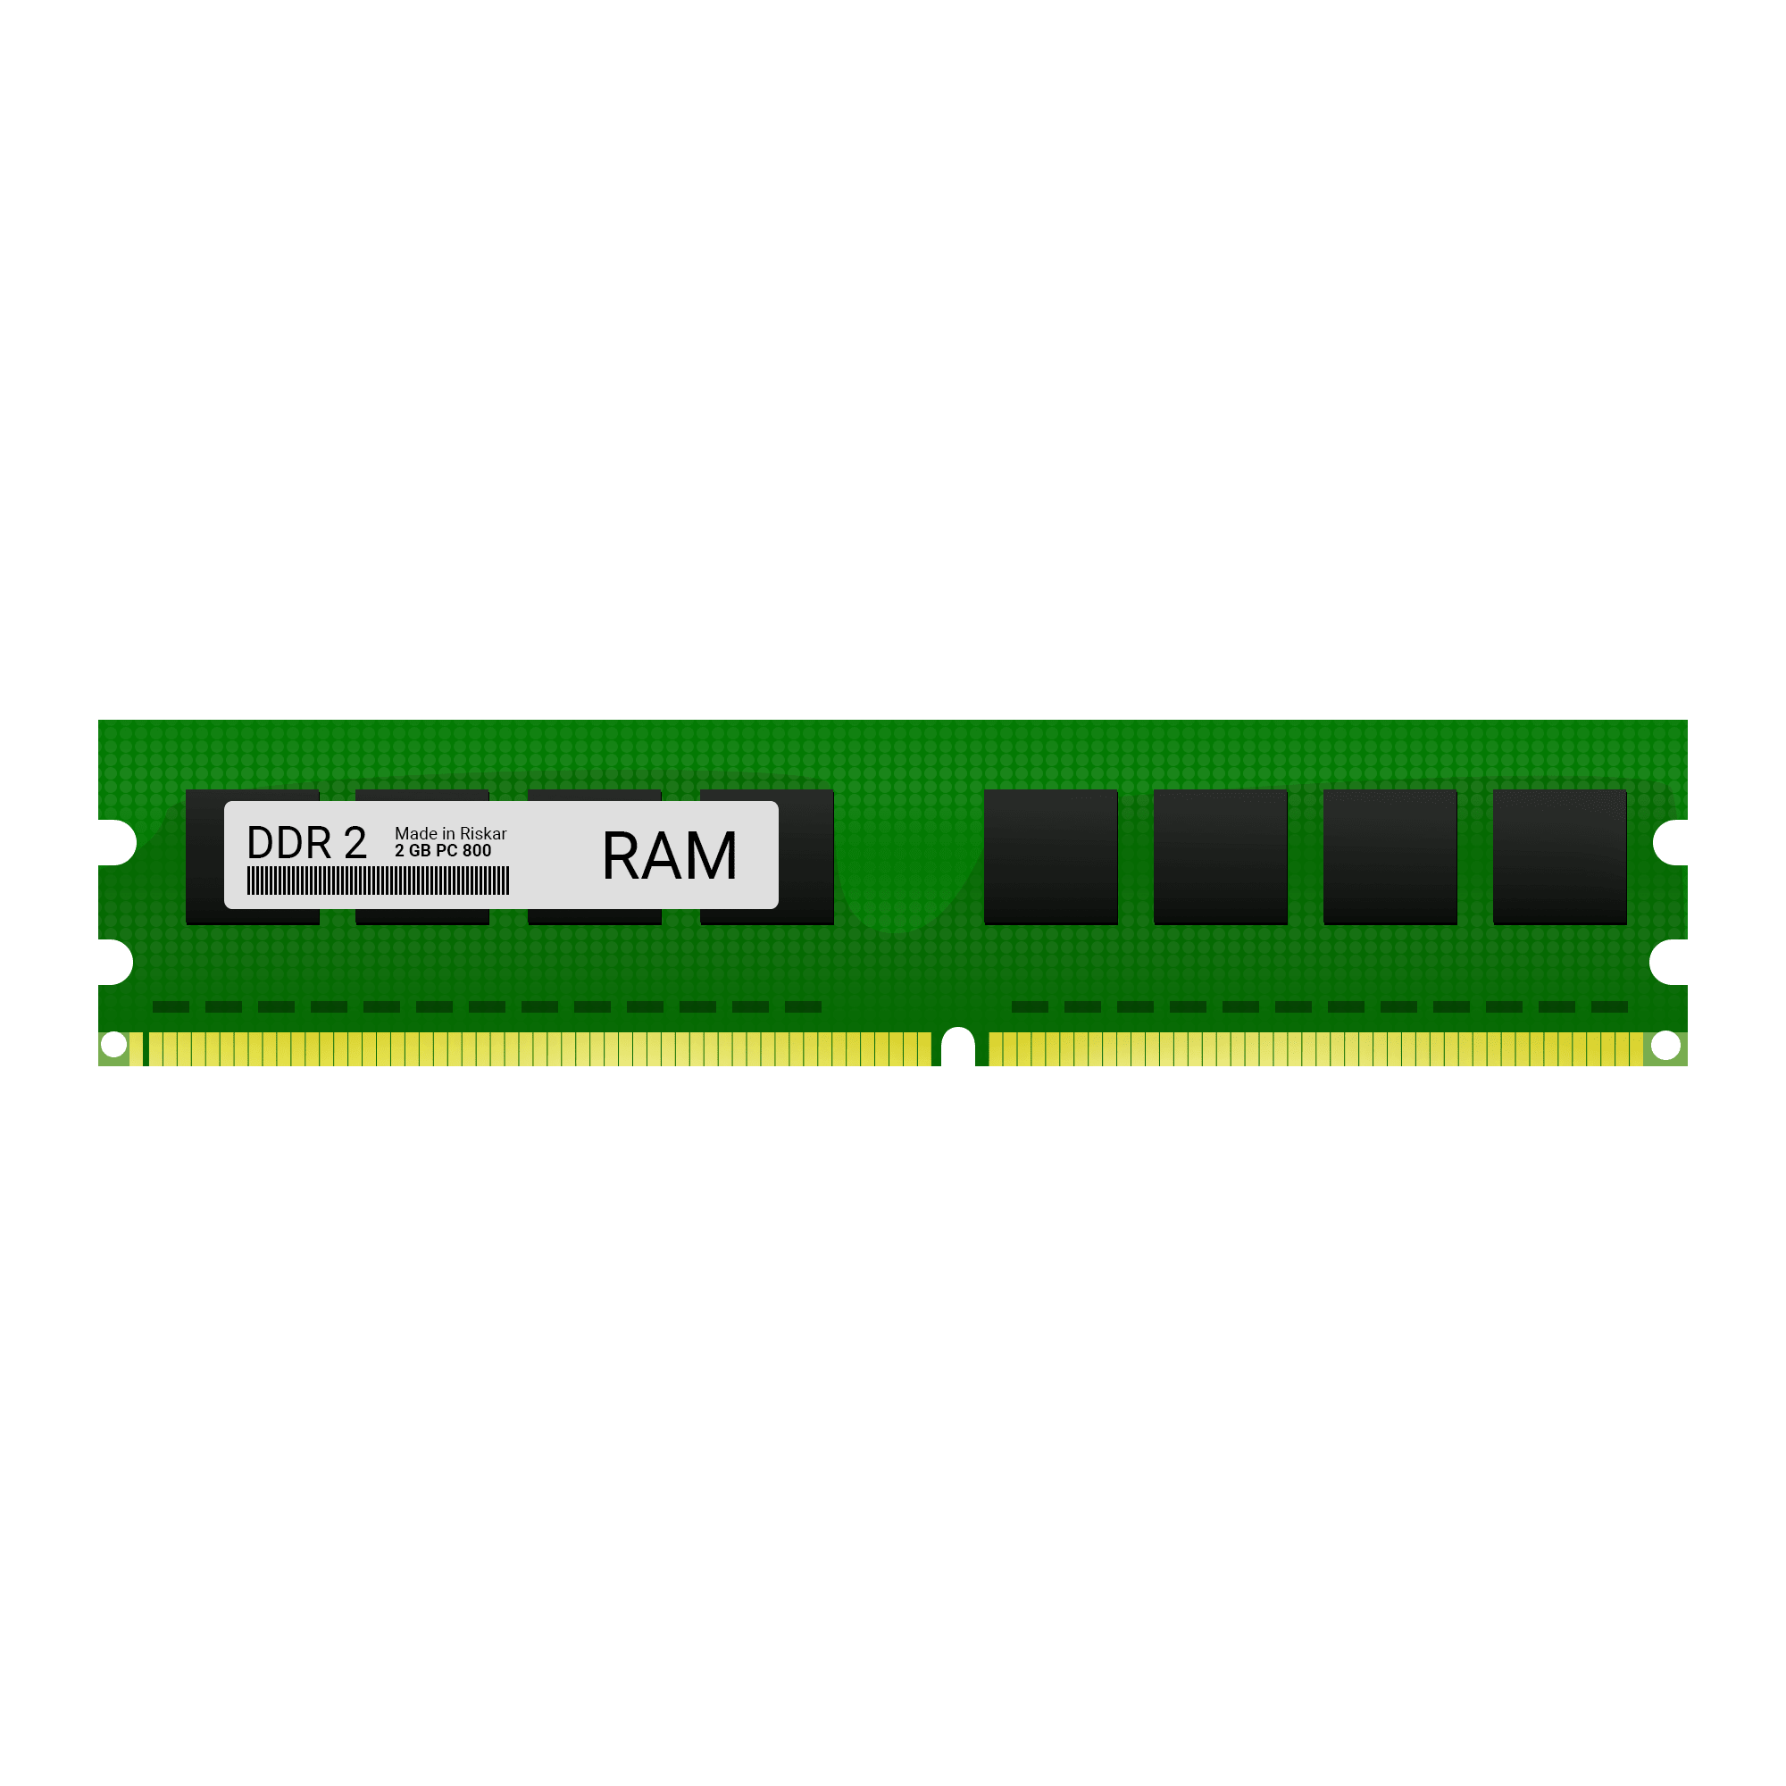
Lesson title
Computer Memory
The Date
2025 / 9 /

Slide 5
1- the quantity of memory occupied in a computer is measured in bytes 2- 1 kilo Byte (kb)=1024 bytes. 3- in a computer, data is stored in a digital storage device or memory device 4- the computer has a management system called the memory management Unit (MMU).

Slide 6
5- RAM (random access memory) 6- GPU (Graphics Processing Unit) 8- When a new program stats on the computer, its information is stored in the RAM. 9- Rom is the permanent memory that stores read only data.

Slide 7
10- the speed to read and write data is faster than HDD. 11- GPU helps us play high definition Video games and make computer animations and drawings.

Slide 8
Start

Slide 9

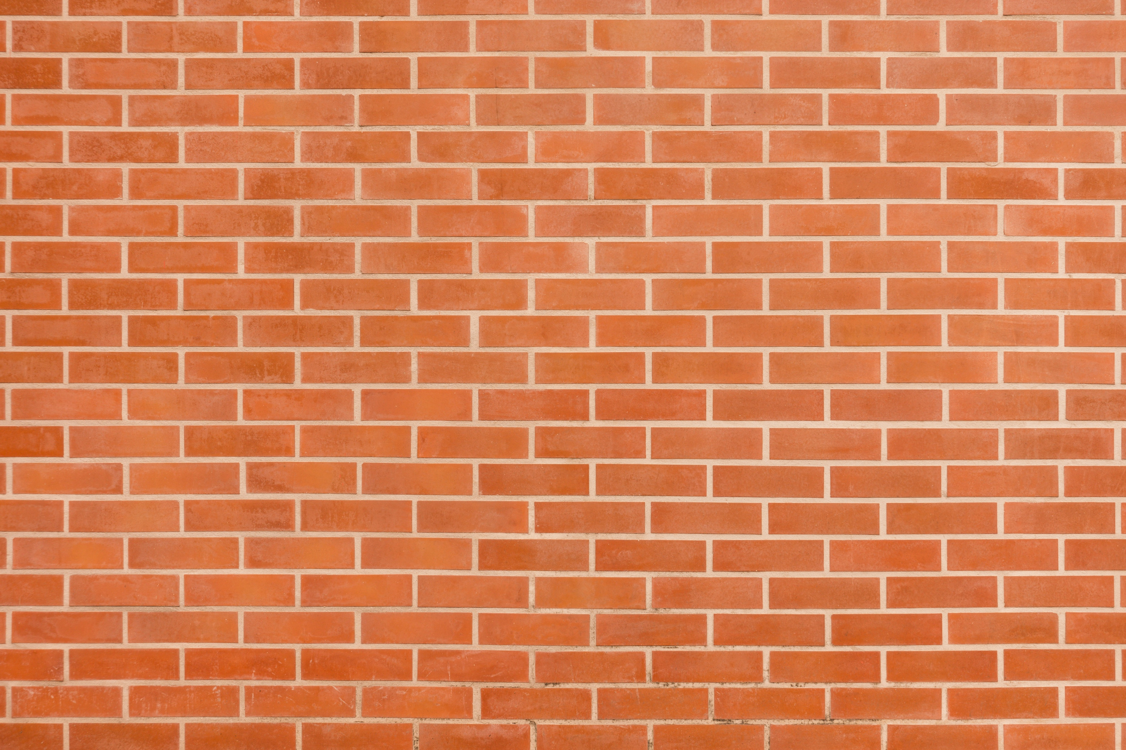
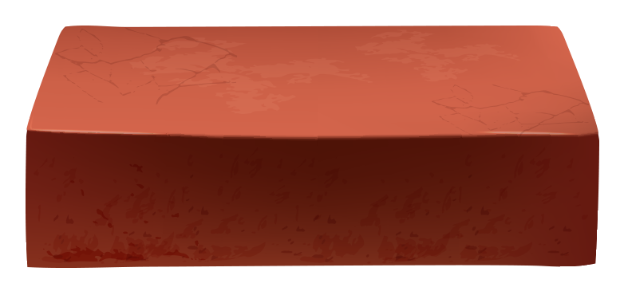



1- the quantity of memory occupied in a computer is measured in Bytes.

Slide 10
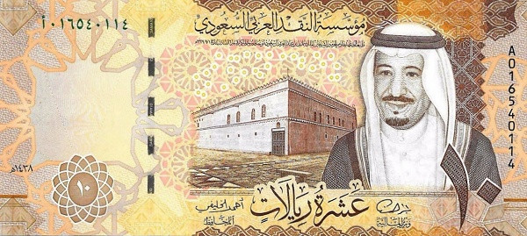
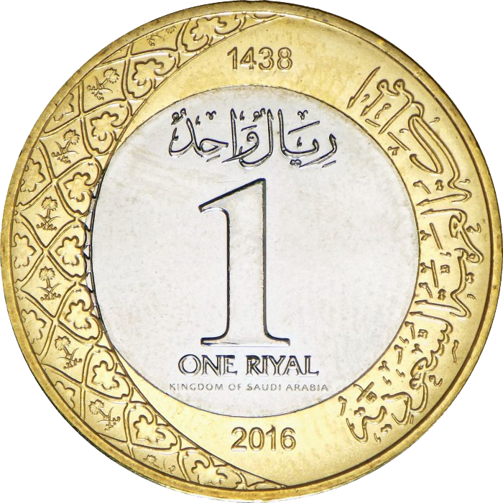
2- 1 kilo Byte (kb) =1024 bytes.

Slide 11
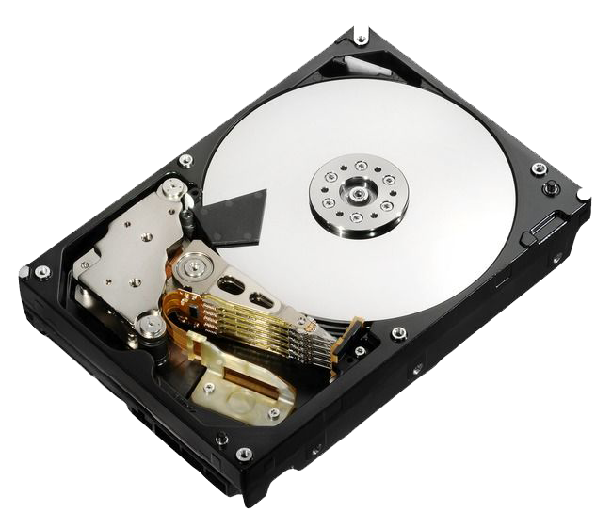
3- in a computer, data is stored in a digital storage device or memory device

Slide 12

We follow the explanation
Yes Or No

Slide 13
4- the computer has a management system called the memory management Unit (MMU).

Slide 14

5- RAM (random access memory)

Slide 15
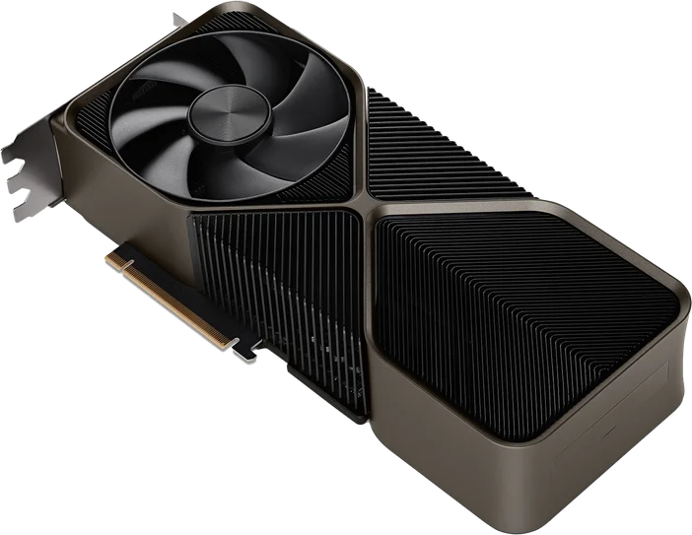
6- GPU (Graphics Processing Unit).

Slide 16
7- When a new program stats on the computer, its information is stored in the RAM.

Slide 17
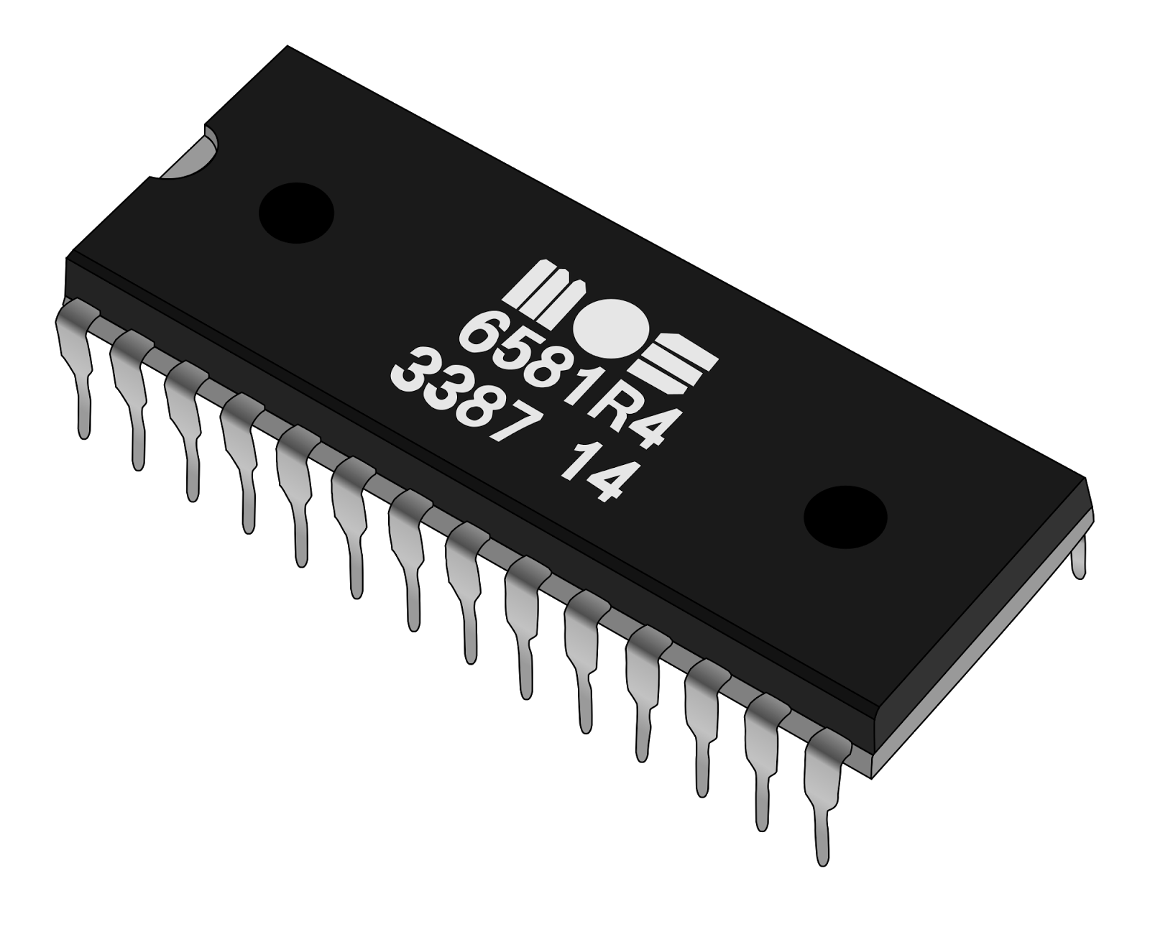
9- Rom is the permanent memory that stores read only data.

Slide 18

10- (SSD) the speed to read and write data is faster than HDD.

Slide 19
11- GPU helps us play high definition Video games and make computer animations and drawings.

Slide 20

Exercise

Slide 21
Page Number 04

Slide 22

The Unit of Memory is …………..

Slide 23

2- If 1KB is 1024 Bytes, then 3 KB is …….. Bytes.

Slide 24
Page Number 07

Slide 25

3- Data in a computer is stored in ______________

Slide 26

4- The unit that manages storage devices in a computer is called ___________

Slide 27

5- The full form of RAM is ______________

Slide 28

6- The full form of GPU is ______________

Slide 29

Homework

Slide 30
Page Number 12

Slide 31

Thank you for everything

